Slide 1
Module-2
Analysing Consumer Behaviour
Presentation by
Dr. Basavaraj S. Kudachimath

Slide 2
Discussion Points
Meaning and Characteristics,
Importance,
Factors Influencing Consumer Behaviour,
Consumer Purchase Decision Process,
Buying Roles,
Buying Motives,
Buyer Behaviour Models.

Slide 3

What is Consumer Behavior
Consumer behavior refers to the set of characters that a consumer exhibit while buying goods and services. It is also called as buying behavior
Buying Behavior is the decision processes and acts of people involved in buying and using products.
It helps to understand:
why consumers make the purchases that they make?
what factors influence consumer purchases?
the changing factors in our society.

Slide 4
Characteristics of Consumer Behavior.
Consumer Behavior is part of human behavior
Learning C.B is difficult and Complex
CB is dynamic
Study of CB is crucial.
C.B is influenced by various factors.

Slide 5
Why a marketers need to know CB
A firm needs to analyze buying behavior for: Buyers reactions to a firms marketing strategy has a great impact on the firms success.
The marketing concept stresses that a firm should create a Marketing Mix (MM) that satisfies (gives utility to) customers, therefore need to analyze the what, where, when and how consumers buy.
Marketers can better predict how consumers will respond to marketing strategies.

Slide 6
Factors affecting Buying Behavior
Motivation
Perception
Learning
Memory
Reference Groups,
Family,
Roles and Status
Social factors, Cultural factors
Psychological Factors
Marketing Mix
Age and Stage in the Life Cycle,
Occupation and Economic Circumstances,
Personality,
Lifestyle
Personal factors
Product Price
Place Promotion

Slide 7
Factors Affecting Consumer Behavior:
Culture
Most basic cause of a person's wants and behavior.
Values
Perceptions
Subculture
Groups of people with shared value systems based on common life experiences.
North Indian Consumers
African American Consumers
Asian American Consumers
Mature Consumers
Social Class
People within a social class tend to exhibit similar buying behavior.
Occupation
Income
Education
Wealth

Slide 8



Factors Affecting Consumer Behavior:
Social
Groups
Membership
Reference
Family
Husband, wife, kids
Influencer, buyer, user
Social Factors
Roles and Status
Notes:
Social Factors
This CTR relates to the material on pp. 140-142.
Group Influence on Brand Choice
Groups vary in their influence on product and brand purchases as illustrated on the CTR. Consumers belong to several different membership groups.
Primary Groups. Primary groups are those with which we have regular but informal interaction. These include family, friends, neighbors, and co-workers.
Secondary Groups. Secondary groups are those with which we have more formal and less regular interaction such as religious groups, professional associations, and trade unions.
Reference Groups. These groups serve as direct (face-to-face) or indirect points of comparison and evaluation in a person’s formation of attitudes or behavior.
Aspirational Groups. This type of group is one to which the individual wishes to belong and emulates in adopting behaviors appropriate to that group.
Opinion Leaders. These are people within a reference group who exert influence over others due to special knowledge, skill, personality, or other characteristic.

Slide 9
Factors Affecting Consumer Behavior:
Personal
Personal Influences
Lifestyle Identification
Age and Family Life Cycle
Stage
Occupation
Economic Situation
Personality & Self-Concept
Activities
Opinions
Interests
Notes:
Factors Affecting Consumer Behavior:
Personal
This CTR corresponds to Table 5-2 on p. 142 and the material on pp. 142-146.
Personal Factors
Age and Family Life-Cycle Stage. Buyers’ choices are affected by changes in their age and family structure over time. Young singles have different tastes in clothes, furniture, food, and recreation than do middle aged persons with their own children. Older consumers continue to change in their preferences and additionally acquire new buyer needs such as increased health care needs.
Occupation. A person’s occupation carries with it distinct consumptive needs. White collar workers need different clothes than blue collar workers. Also, occupations usually carry their own subcultural norms and values that influence buyer behavior.
Economic Situation. Means constrain buyer behavior for almost everyone except for the most wealthy.
Personality and Self-Concept. Personality refers to the unique psychological characteristics that lead to relatively consistent and lasting response to one’s own environment. Self-concept is the basic perception that people have about who they are.
Lifestyle
Lifestyle is a person’s pattern of living as expressed in her or his activities, interests, and opinions. Determining lifestyle involves measuring AIO dimensions -- the Activities, Interests, and Opinions of consumers.
Psychographics. Lifestyle measures combined with demographic information can identify distinct market segments for consumer products and services. The best known of these methods, VALS 2, is addressed on the following CTR.

Slide 10



Factors Affecting Consumer Behavior:
Psychological
Motivation
Psychological
Factors
Beliefs and
Attitudes
Perception
Learning

Slide 11
Maslow’s Hierarchy of Needs
Self
Actualization
(Self-development)
Esteem Needs
(self-esteem, status)
Social Needs
(sense of belonging, love)
Safety Needs
(security, protection)
Physiological Needs
(hunger, thirst)
Notes:
Maslow’s Hierarchy of Needs
Maslow suggests that lower level needs must be satisfied before individuals become motivated to satisfy higher level needs. Thus consumers will respond to lower level products and promotions until those needs are met. Only then can other marketing offers be of interest. Needs include:
Physiological. Physical needs such as hunger, thirst, and bodily functions are the lowest level need and require satisfaction before other needs become important to the individual. Sometimes this helps students understand the difference between needs and wants. A thirsty person may still want an expensive car but if thirsty enough will take a drink of water.
Safety. Safety needs for security and protection are the next level needs in the hierarchy. So long as physiological needs are met, safety needs will take precedence over other needs. Fear appeals for consumer products are often linked to safety needs.
Social. Human beings are social, gregarious animals. We group together in part to fulfill physiological and safety needs but also because we enjoy and need the company of others. Going to malls to "hang out" fulfills social needs.
Esteem. To be recognized as an individual fulfills esteem needs. Self-esteem is the value a person places on himself or herself. As lower level needs become more stable, esteem needs become more important to the individual.
Self-actualization. Beyond esteem needs very successful people may still be driven to improve themselves and "accomplish something." These people are driven to self-actualize their potential.
Maslow’s Hierarchy of Needs
This CTR relates to the material on p. 146-147 and corresponds to Figure 5-4.

Slide 12
Buying Motives

Slide 13

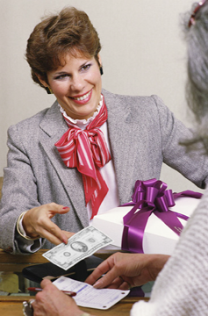
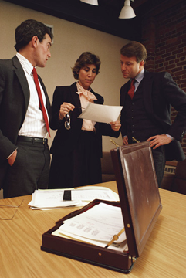
Buying Motives
Reasons or benefits that cause people to purchase products to satisfy their wants and needs

Slide 14
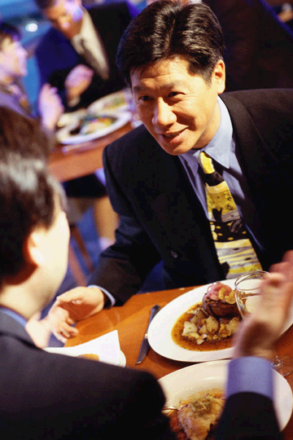
Why to Buy a costly meal in five star hotel?
Buying Motives
To be viewed as a certain type of person
To make business contacts
To socialize with others in age/professional group
A customer needs food and wants a such costly meal at a certain hotels.

Slide 15
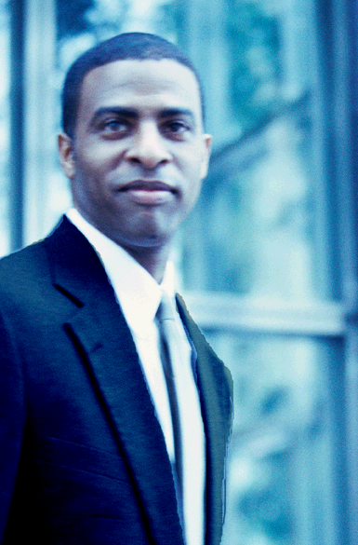
Why Buy a Blazer?
Buying Motives
The blazer is stylish.
Everybody has one.
He thinks he looks good in blue.
A customer needs clothing and wants to buy a navy blue blazer.

Slide 16

Customers Know/Don’t Know Their Buying Motives
Why am I
buying this?
?
?
?

Slide 17
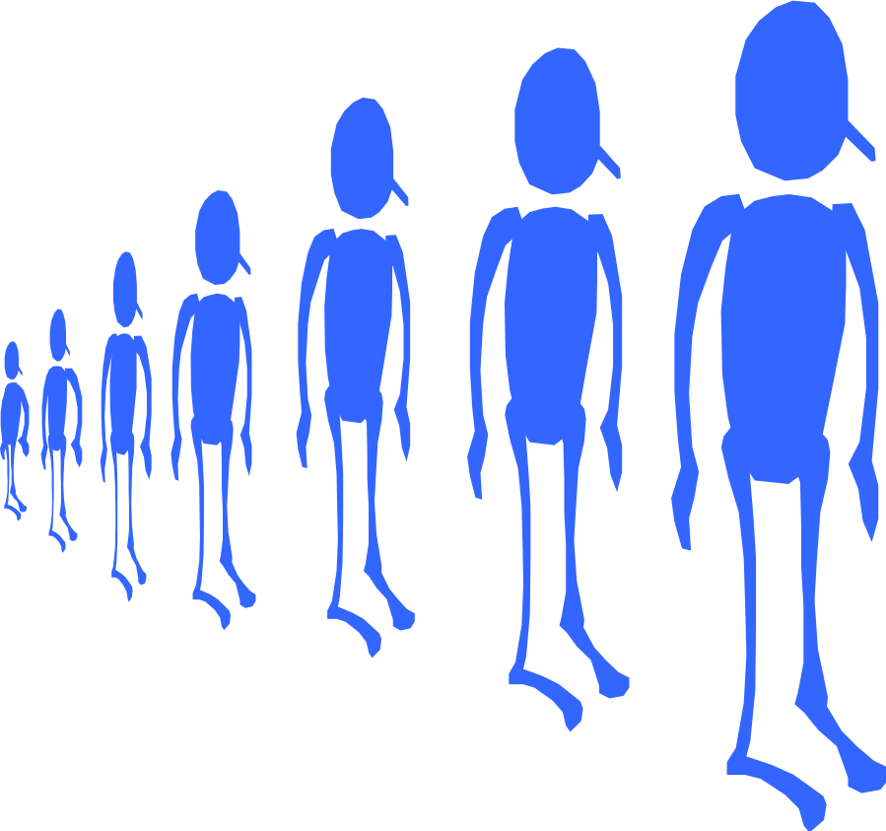
Knowing customers’ needs, wants, and motives lets you tailor your presentation to each customer.

Slide 18



Motives Change
From customer to customer
From time to time

Slide 19
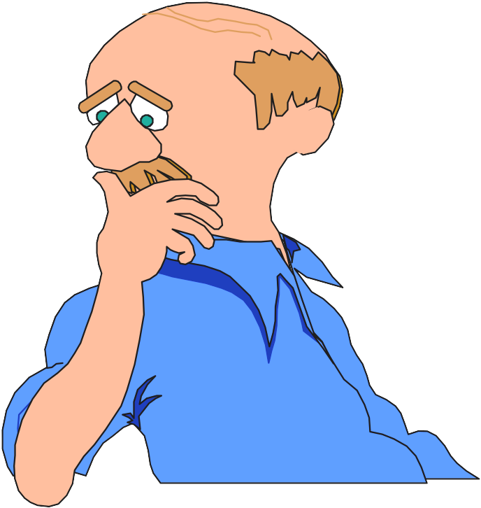
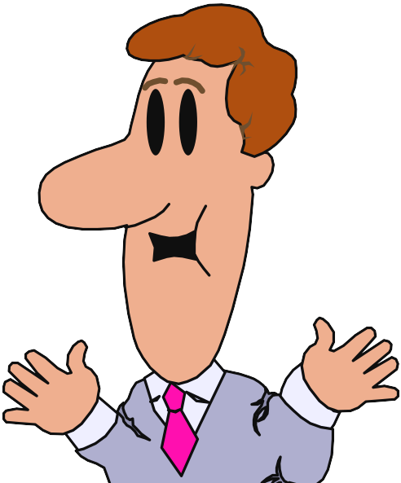
Types of Buying Motives
Emotional
Rational

Slide 20
Emotional Motives
Adventure
Affection
Appearance
Customers often unaware of them
Easily influenced by advertising and current styles
Change/Variety
Comfort/Convenience
Fear
Leisure time
Pleasure
Recreation
Recognition
Feelings, Emotions, Impulses
Social or group approval
Security

Slide 21
Rational Motives
Accuracy
Convenience
Pros and cons
Customer awareness
Bottom line
Money’s worth
Durability
Dependability
Efficiency
Economy
Increased production
Health
Knowledge
Low cost/maintenance
Profit
Quality of workmanship/materials
Reason, Judgment, Logic
Safety
Service
Simplicity
Versatility

Slide 22
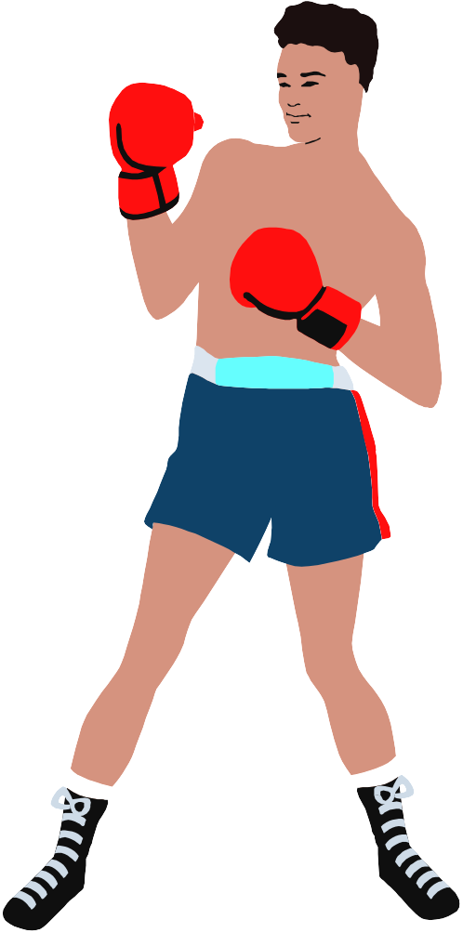
Relationship of Emotional and Rational Motives
Emotional
Rational
Motives
Combine
Conflict

Slide 23
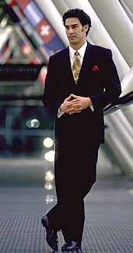
Emotional Motives
Appearance
Prestige
Rational Motives
Durability
Quality
Versatility

Slide 24
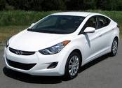
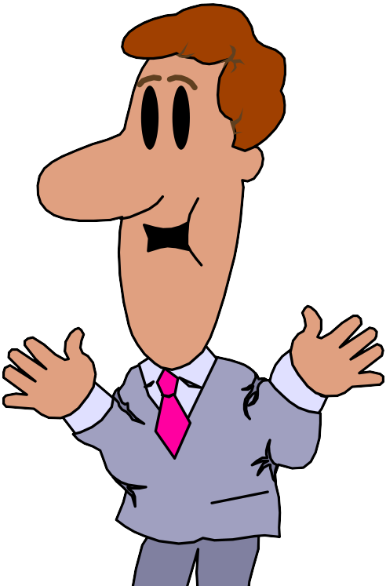
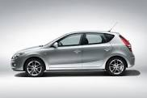
Conflicting situations
Which one I should buy?

Slide 25
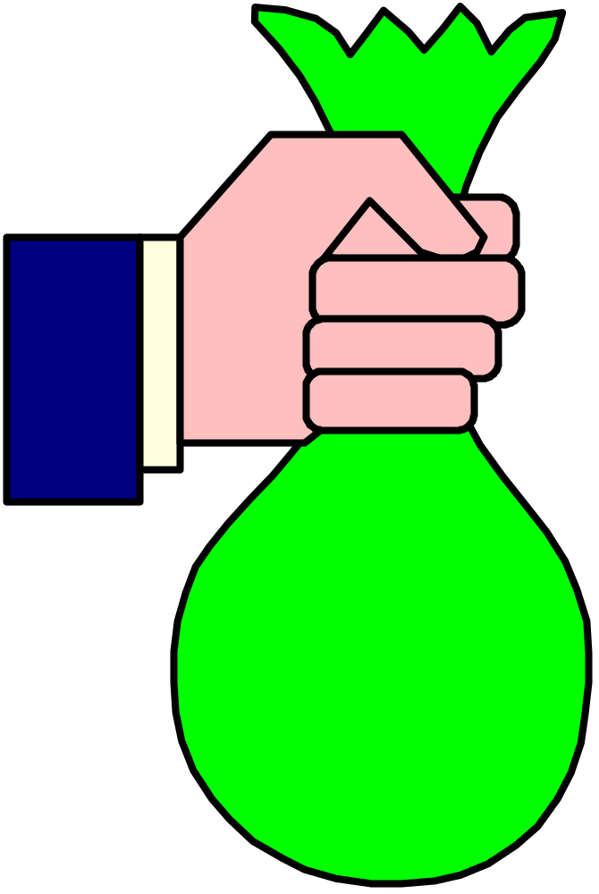
We all have emotional motives for buying certain items, but we like to justify spending our money.
$

Slide 26
People prefer to believe that they are buying on the basis of rational motives.
“But I really do
need that sedan class diesel car but it is costly.
Is it worth to buy?”

Slide 27
Responsibilities of Salesperson
Pointing out benefits that appeal to customer’s rational thinking
Comparing lists of rational and emotional motives to find out which motives appear on both lists
Determining if the customer is buying for emotional or rational motives
Focusing sales presentation on the customer’s buying motives

Slide 28


Patronage Motives
Customer makes purchases in one business rather than another.
These motives can be rational or emotional.
WildsugarBakery
Swamy
Bakery

Slide 29

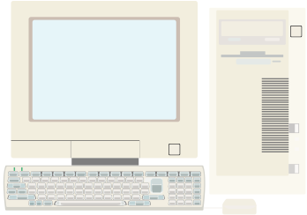
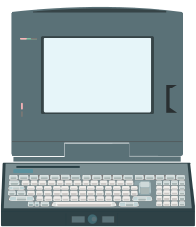
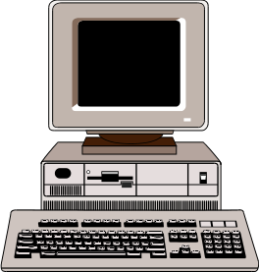
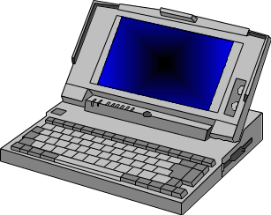
Examples
$
Computers same warranty and discuounts offord by all sellers
Customer services and policies
Price
Courteous sales staff
Product
Product assortment
Fashion

Slide 30
Buying Decisions

Slide 31
Types of Buying Decisions
Complex/ Extensive
Buying
Behavior ( Eg:Cars, bikes etc)
Variety-
Seeking/ Impulsive
Behavior ( Shampoo/ Cosmetic)
High
Involvement
Low
Involvement
Significant
differences
between
brands
Dissonance-
Reducing/ Iimited Buying
Behavior( Clothes, Rugs etc)
Habitual/ Routine
Buying
Behavior (Salt, oil, LPG gas etc)
Few
differences
between
brands
Notes:
Types of Buying Decisions
This CTR corresponds to Figure 5-5 on p. 151 and relates to the material on pp. 151-152.
Types of Buying Decision Behavior
Complex Buying Behavior. Consumers undertake this type of behavior when they are highly involved in a purchase and perceive differences among brands. Involvement increases with the product is expensive, infrequently purchased, risky, and highly self-expressive.
Dissonance-Reducing Buying Behavior. Consumers engage in this behavior when they are highly involved with an expensive, infrequent, or risky purchase, but see little difference among brands. Without objective differentiation to confirm the purchase, buyers often seek support to reduce postpurchase dissonance -- the feeling they may have made the wrong decision.
Habitual Buying Behavior. This behavior occurs under conditions of low consumer involvement and little significant brand differences. Consumers do not search extensively for information about brands. Brand familiarity aids in promoting products under essentially passive learning conditions.
Variety-Seeking Buying Behavior. Consumers may seek variety when involvement is low and there are significant perceived differences among brands. Differences may be product features -- new taste, improvements, extra ingredients -- or promotional benefits such as coupons, rebates, and price reductions.

Slide 32
The Buyer Decision Process
Need Recognition
Information Search
Evaluation of Alternatives
Purchase Decision
Postpurchase Behavior
Notes:
The Buyer Decision Making Process
This CTR corresponds to Figure 5-6 on p. 153 and relates to the material on pp. 152-156.
Teaching Tip: Consider asking students to describe some of their purchases decisions made at the beginning of the term and link them to steps in the process.
Stages in the Buyer Decision Process
Need Recognition. Problems are recognized when people sense a difference between an actual state and some desired state. Problem recognition can be triggered by either internal or external stimuli.
Information Search. Consumers vary in the amount of information search they conduct. Information search may be a survey of information stored in memory or may be based upon information available externally. Search effort varies from heightened awareness corresponding to increased receptivity for relevant information to active information search modes where the person expends some energy to obtain information that is desired. External information vary in their informational and legitimizing characteristics. Riskier decisions usually elicit more search behavior than non-risky decisions.
Evaluation of Alternatives. Following information search, the person compares decisional alternatives available. Criterion for evaluation compares product attributes of the alternatives against degrees of importance each attribute has in meeting needs, beliefs about the product or brand's ability and utility, and an evaluation procedure that ranks the alternatives by preference that forms an intention to buy.
Purchase Decision. - The individual buys a product. Purchasing other than the intended product may be due to attitudes of others exerted after the evaluation of alternatives is completed or unexpected situational factors such as point of purchases promotions that affect the alternatives' ranking.
Post-purchase Behavior. This involves comparing the expected performance of the product against the perceived performance received. Cognitive dissonance describes the tendency to accentuate benefits and downplay shortcomings.

Slide 33
The Buyer Decision Process
Step 1. Need Recognition
Need Recognition
Difference between an actual state and a desired state
Internal Stimuli
Hunger
Thirst
A person’s normal
  needs
External Stimuli
TV advertising
Magazine ad
Radio slogan
Stimuli in the
  environment

Slide 34

The Buyer Decision Process
Step 2. Information Search
Personal Sources
Commercial Sources
Family, friends, neighbors
Most influential source of
information
Public Sources
Advertising, salespeople
Receives most information
  from these sources
Experiential Sources
Mass Media
Consumer-rating groups
Handling the product
Examining the product
Using the product

Slide 35
The Buyer Decision Process
Step 3. Evaluation of Alternatives
Product Attributes
Evaluation of Quality, Price, & Features
Degree of Importance
Which attributes matter most to me?
Brand Beliefs
What do I believe about each available brand?
Total Product Satisfaction
Based on what I’m looking for, how satisfied
would I be with each product?
Evaluation Procedures
Choosing a product (and brand) based on one
or more attributes.

Slide 36


The Buyer Decision Process
Step 4. Purchase Decision
Purchase Intention
Desire to buy the most preferred brand
Attitudes of others
Unexpected situational factors
Purchase Decision

Slide 37


The Buyer Decision Process
Step 5. Postpurchase Behavior
Consumer’s Expectations of
Product’s Performance
Product’s Perceived
Performance
Satisfied
Customer!
Dissatisfied Customer
Cognitive Dissonance

Slide 38
Buying Roles
Buying roles are the different functions performed by individuals within a group during the purchase process, such as initiator, influencer, decider, buyer, user, and gatekeeper. These roles can be filled by different people or one person can perform multiple roles, and they are common in both business and family purchases

Slide 39
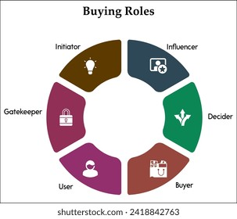
Initiator (suggests the need),
Influencer (provides advice),
Decider (makes the final choice),
Buyer (executes the purchase),
User (consumes the product), and
Gatekeeper (controls information flow).

Slide 40
Buying Behavior Models

Slide 41
Important models of consumer behaviour:
The Economic Model
Learning Model
Psychological Model
The Sociological Model
The Howard Sheth Model of buying behaviour
The Nicosia Model
The Engle-Kollat-Blackwell Model
Engle, Blackwell and Miniard (EBM) Model
Webstar and Wind Model of organizational buying behaviour
The Sheth Model of Industrial buying

Slide 42
Traditional Models
Contemporary Models
Black Box Model
The Howard Sheth Model of buying behaviour
The Nicosia Model
The Engle-Kollat-Blackwell Model
Engle, Blackwell and Miniard (EBM) Model
Webstar and Wind Model of organizational buying behaviour
The Sheth Model of Industrial buying
The Economic Model
Learning Model
Psychological Model
The Sociological Model
Notes:
Traditional models:- these models were developed by economists with a view to understand economic systems.
Contemporary models:- these models evolved as newer approaches to understand what are influencing consumer behaviour these models focused on the decision process adopted by consumers and borrowed concepts from behavioural sciences field.

Slide 43


Understanding the Black Box Model of Consumer Behaviour
Decoding the mystery of how consumers make purchasing decisions in today's complex marketplace.

Slide 44
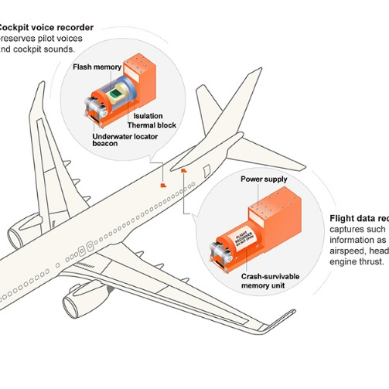
What is the Black Box Model?
The Black Box Model treats the consumer's mind as an enigmatic "black box" — a space where internal thoughts, emotions, and decision-making processes remain hidden and incredibly complex.
Marketers observe external stimuli such as advertisements, pricing strategies, and product features, then track consumer responses like purchasing decisions, without fully understanding the intricate mental processes occurring inside.
Originating from behavioural science principles, this model provides marketers with a framework to decode how consumers react to marketing efforts, even when the internal psychological factors remain largely unknown.

Slide 45
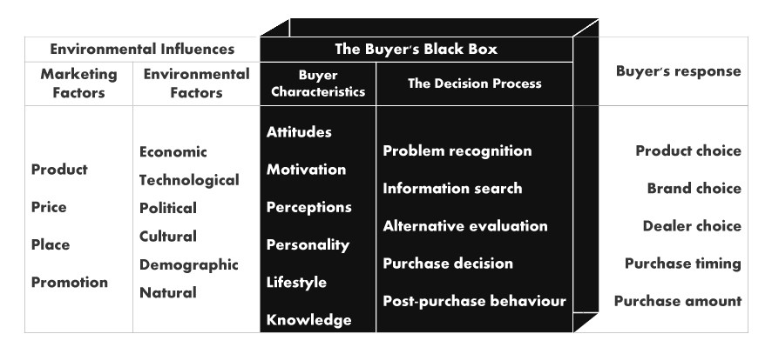
Key Components of the Model
INPUT
PROCESS
OUTPUT
Real-World Example
A buyer of Mumbai staying in America encounters a vibrant festive advertisement showcasing traditional sweets during Diwali (stimulus). They process this information based on personal beliefs, family traditions, and budget considerations (black box). Finally, they decide to purchase a specific premium brand of sweets from their trusted local shop (response).

Slide 46

Why Marketers Must Use the Black Box Model
Predictive Power
Cultural Adaptation
Strategic Decisions
Links observable stimuli to measurable responses, enabling prediction of consumer behaviour despite hidden mental processes.
Enables tailored marketing strategies for diverse Indian consumers influenced by regional culture, social class, and personal preferences.
Supports product development, pricing, and promotional decisions across all stages of the buyer journey.
01
02
03
Problem Recognition
Information Search
Evaluation
Consumer identifies a need
Explores available options
Compares alternatives
04
05
Purchase
Post-Purchase
Makes final decision
Reflects on satisfaction
Key Takeaway: Though the consumer's mind remains a "black box," this powerful model guides marketers to forge stronger connections with their audience, craft more effective campaigns, and ultimately drive sales growth in competitive markets.

Slide 47
Why Marketers Must Use the Black Box Model
Predictive Power
Cultural Adaptation
Strategic Decisions
Links observable stimuli to measurable responses, enabling prediction of consumer behaviour despite hidden mental processes.
Enables tailored marketing strategies for diverse Indian consumers influenced by regional culture, social class, and personal preferences.
Supports product development, pricing, and promotional decisions across all stages of the buyer journey.
01
02
03
Problem Recognition
Information Search
Evaluation
Consumer identifies a need
Explores available options
Compares alternatives
04
05
Purchase
Post-Purchase
Makes final decision
Reflects on satisfaction
Key Takeaway: Though the consumer's mind remains a "black box," this powerful model guides marketers to forge stronger connections with their audience, craft more effective campaigns, and ultimately drive sales growth in competitive markets.

Slide 48
THANK YOU

